Slide 1
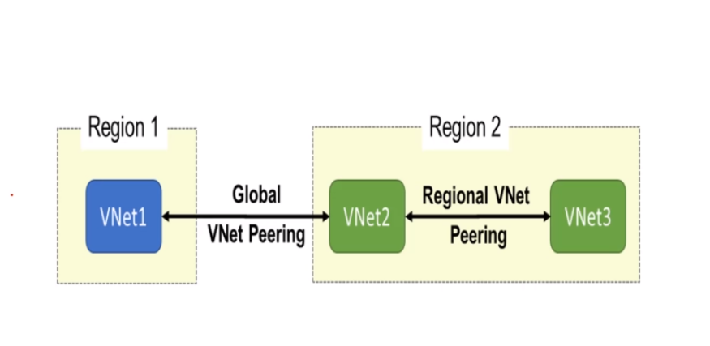
Azure VNet Peering
Use case :
Creating two Virtual Machines in different regions in two different VNet , configure peering between to establish connection.
Description :
Create a two virtual networks as VNet 1 : 10.0.0.0/8 ; SN1 : 10.1.0.0/16; VNet 2 : 172.0.0.0/8 SN : 172.16.0.0/16, and create resource group in regions west central us, East US and create virtual machines VM 1 , VM2 in And VNet1 and 2 are different region , configure vnet peering
Step Wise details of Implementation of VNet Peering
Step 1 : Creating VNet1[SN1] [AkmetRG1] and VNet2 [SN2][AkmetRG2]
Step 2 : Creating VM1 [AkmetRG1] and VM2[AkmetRG2] – win server 2016
Step 3 : Check Connectivity between VM1 and VM2 before VNet Peering using RDP/mstsc
Step 4 : Configure VNet Peering between [Vnet→ peerings] →Vnet1-to-Vnet2 & Vnet2-to-Vnet1
Step 5 : Verify VNet Peering Connectivity post configuration

Slide 2
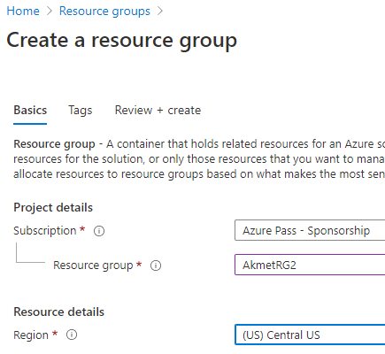
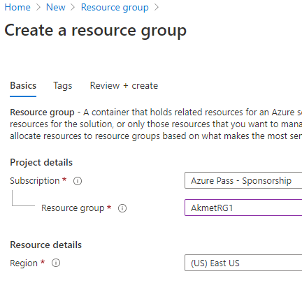
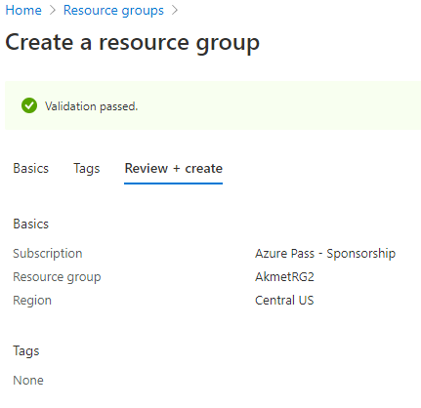
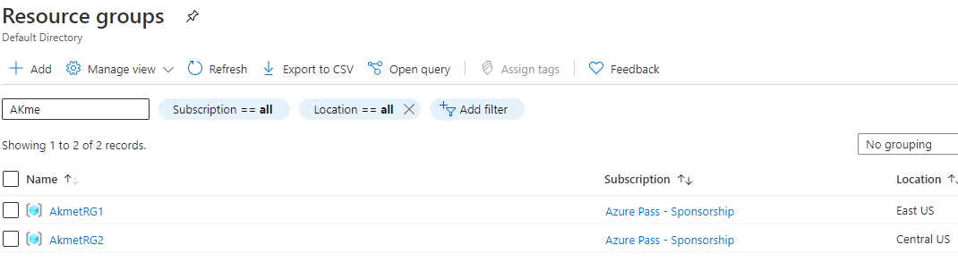
Creating Resource Groups
Step 1 : Create a resource group
Login to azure portal
Create a resource : AkmetRG1& AkmetRG2
Navigate to Resource blade and check resource groups are created in regions East US & Central US respectively

Slide 3
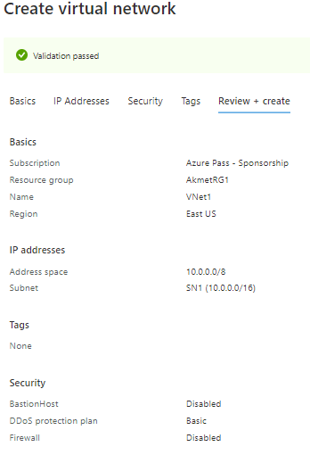
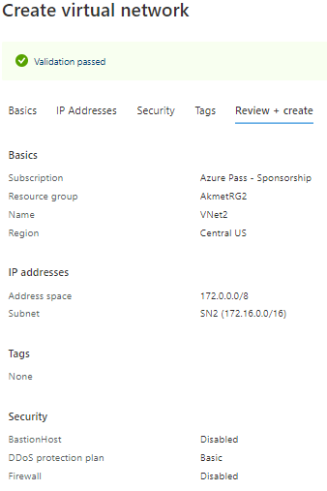
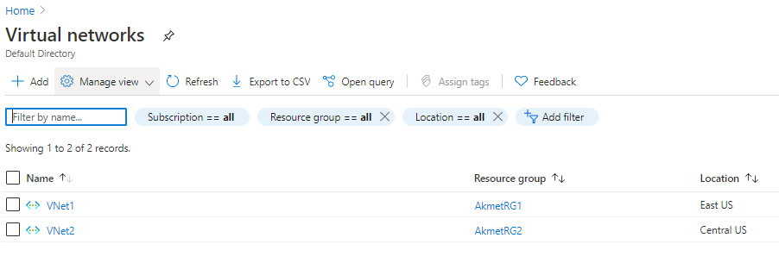
Create VNet, Subnets
Step 1 : Create a Virtual Networks VNet1[SN1] [AkmetRG1] & VNet2 [SN2][AkmetRG2]
Login to azure portal
Create a VNet1 [10.0.0.0/8 ; SN1 : 10.1.0.0/16], VNet2 [172.0.0.0/8 SN : 172.16.0.0/16]
Navigate to virtual network blade and check vnets are created along with subnets.

Slide 4
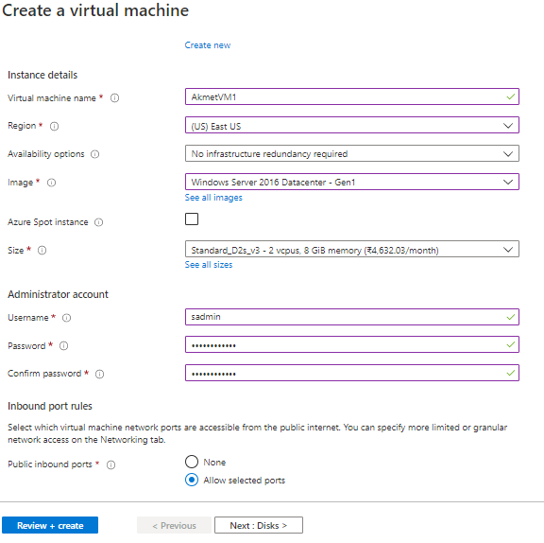
Create Virtual Machine
Step 1 : Create a Virtual Networks VNet1[SN1] [AkmetRG1] & VNet2 [SN2][AkmetRG2]
Login to azure portal, Navigate Virtual Machine blade and create AkmetVM1 & AkmetVM2

Slide 5
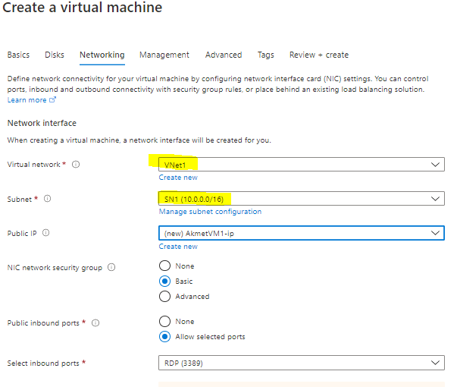
Configure Networking details
Click on Review and Create

Slide 6
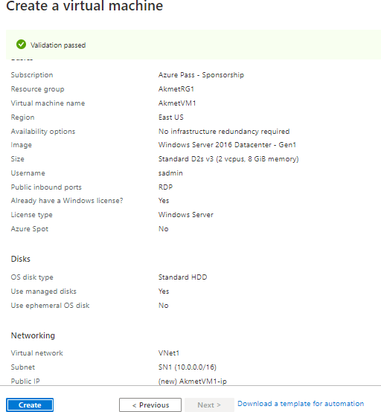
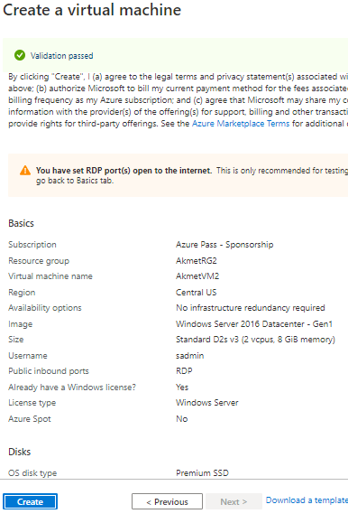
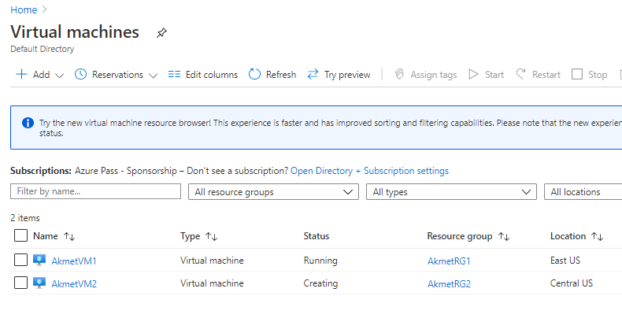
VM validation and Creation

Slide 7
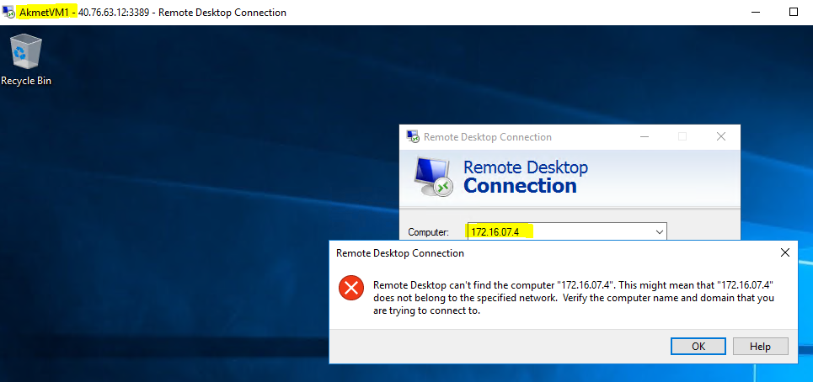
Verify VNet Peering Connectivity
Step 1 : Login to Virtual Machines and check
Take the Private IP of VM1 and try to login from VM2 using mstsc / RDP
Connection fail
Navigate to Resource blade and check resource groups are created in regions East US & Central US respectively

Slide 8
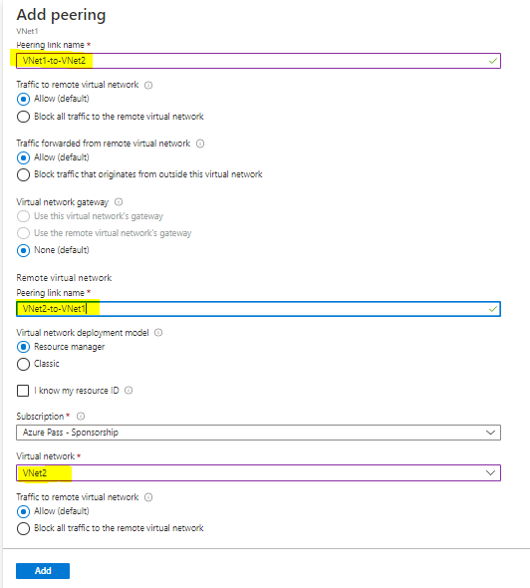
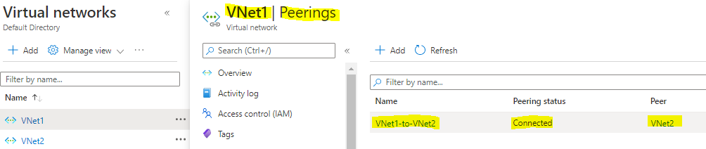
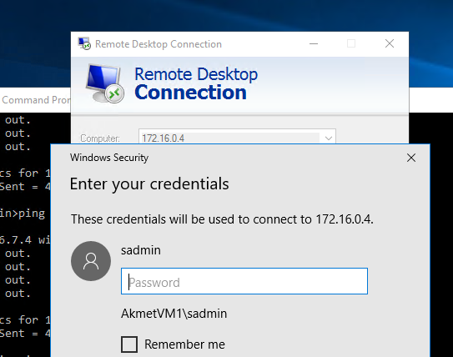
Configure VNet Peering
Step 1 : VNet Peering Configuration
Navigate Virtual Network blade and click on peering , provide peering link name for both and click on add
Connection successful
Now try to login to VM1 from VM2 using mstsc / RDP , successful

